Slide 1
UNIT 4 CHART TYPES AND THEIR USAGE IN TABLEAU
By: Amanpal Singh
Assistant Progessor
LPU, Phagwara
https://www.linkedin.com/in/amanpal-rayat/

Slide 2
Table of Contents
Defining data and their different visualization ways.
Building various charts: Visualizing data using Bar Chart, Lines Charts, Scatterplots, Heat maps, Histograms, Maps, Dual Axis Charts ,Pie Charts.
Visualization data with advanced analytics Polygon Maps, Bump Charts, Control charts, Funnel charts, Pareto charts, Waterfall charts.
Usage and filtration of data with charts, Visualizing categorical data, Visualizing time series data, Visualizing multiple variables, Visualizing geospatial data, Mapbox integrations.
Web Mapping Services, Background Images.

Slide 3
1. Defining data and their different visualization ways.
Data visualization is the graphical representation of information and data.
By using visual elements like charts, graphs, and maps, data visualization tools provide an accessible way to see and understand trends, outliers, and patterns in data.
The primary purpose of data visualization is to make complex data more understandable, interpretable, and actionable.

Slide 4
common ways data can be visualized:
Line Chart: This is a basic chart type where data points are connected by lines. It's often used to show trends over time.
Bar Chart: A bar chart represents data with rectangular bars. The length of each bar corresponds to the value it represents. It's effective for comparing quantities of different categories.
Pie Chart: A pie chart shows proportions of a whole by dividing a circle into slices. Each slice represents a category's share of the total.
Scatter Plot: Scatter plots display individual data points on a two-dimensional graph. They're useful for visualizing relationships between two variables.

Slide 5
Histogram: Histograms are similar to bar charts but represent the distribution of a continuous variable by dividing the data into intervals (bins) and displaying the frequency of data points within each bin.
Heatmap: Heatmaps use colors to represent data values in a matrix. They're often used to visualize the intensity of values in a two-dimensional dataset.
Box Plot (Box-and-Whisker Plot): Box plots summarize the distribution of a dataset by showing the median, quartiles, and outliers. They're useful for identifying variability and skewness in data.

Slide 6
Bubble Chart: Bubble charts represent data points with circles whose size and/or color can be used to encode additional information.
Map: Maps visualize spatial data by representing geographical areas and overlaying them with data points or thematic layers to show patterns or distributions across regions.
Treemap: Treemaps display hierarchical data using nested rectangles. The size and color of each rectangle can represent different attributes of the data.

Slide 7
Network Diagram: Network diagrams represent relationships between entities as nodes and connections between them as edges. They're useful for visualizing complex networks such as social networks or organizational structures.
Word Cloud: Word clouds visually represent the frequency of words in a text by varying the size of each word based on its frequency.
The choice of visualization depends on the nature of the data, the insights you want to extract, and the audience you're presenting to.

Slide 8
2. Building various charts
A chart is a graphic representation of data that transforms the data into visual components.
a drawing that shows information in a simple way, often using lines and curves to show amounts
https://www.tableau.com/learn/whitepapers/which-type-chart-or-graph-right-for-you-ungated
https://help.tableau.com/current/pro/desktop/en-us/dataview_examples.htm

Slide 9
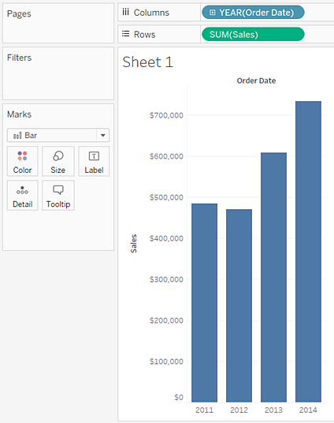
2.1 Bar Chart
Use bar charts to compare data across categories. You create a bar chart by placing a dimension on the Rows shelf and a measure on the Columns shelf, or vice versa.
A bar chart uses the Bar mark type. Tableau selects this mark type when the data view matches one of the two field arrangements

Slide 10
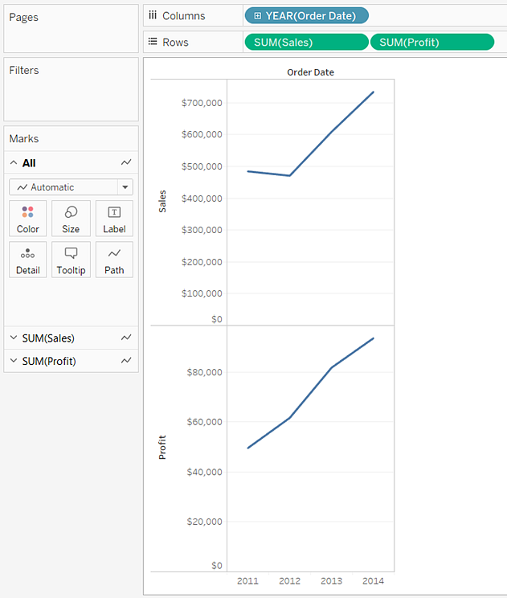
2.2 Line charts
Line charts connect individual data points in a view.
They provide a simple way to visualize a sequence of values and are useful when you want to see trends over time, or to forecast future values.

Slide 11
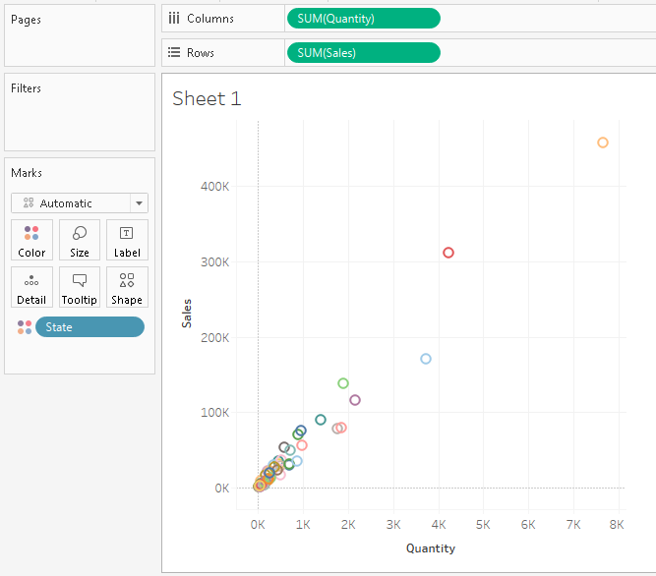
2.3 Scatterplots
By placing at least one measure on the Columns shelf and at least one measure on the Rows shelf.
If these shelves contain both dimensions and measures, Tableau places the measures as the innermost fields which means that measures are always to the right of any dimensions that you have also placed on these shelves.

Slide 12
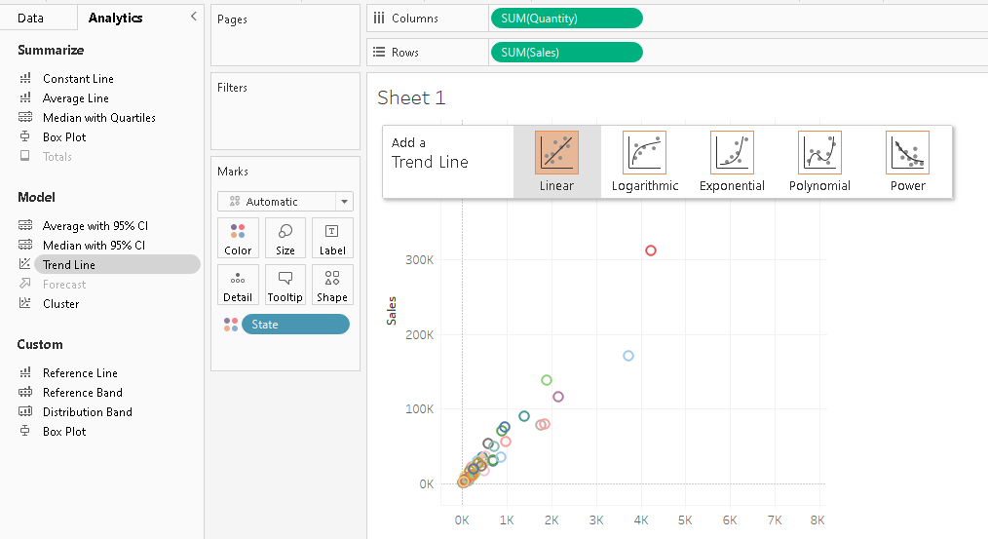
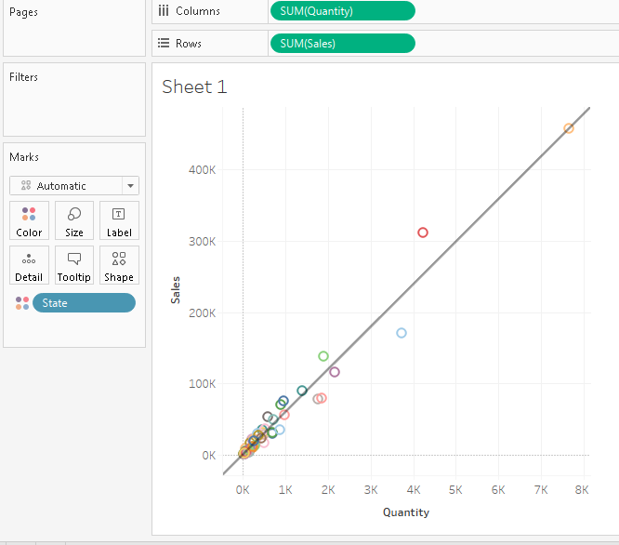
Scatterplots analytics

Slide 13
2.4 Heat maps
Use density chart to visualize patterns or trends in dense data with many overlapping marks.
Tableau does this by grouping overlaying marks, and color-coding them based on the number of marks in the group.
Density maps help you identify locations with greater or fewer numbers of data points.
You can create a chart using the density mark by placing at least one continuous measure on the Columns shelf, and at least one dimension or measure on the Rows shelf (or vice versa), and then adding a field to the Marks card.
Mark type: | Density
Rows and Columns: | At least one continuous measure, and at least one measure or dimension
Marks card: | At least one continuous measure

Slide 14
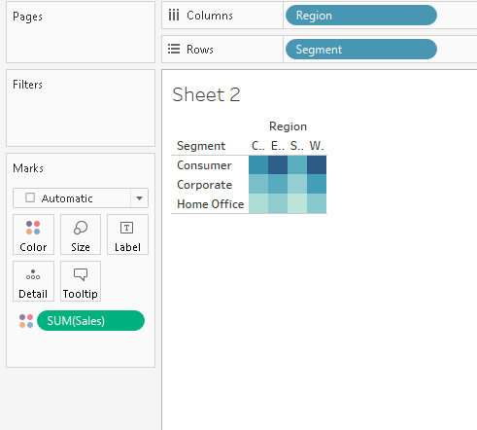

Slide 15
2.5 Histograms
A histogram is a chart that displays the shape of a distribution.
A histogram looks like a bar chart but groups values for a continuous measure into ranges, or bins.
A histogram is a graph that shows the frequency of numerical data using rectangles.
The height of a rectangle (the vertical axis) represents the distribution frequency of a variable (the amount, or how often that variable appears).

Slide 16
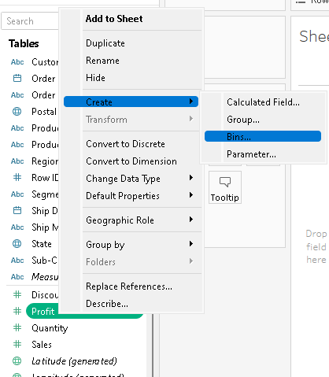
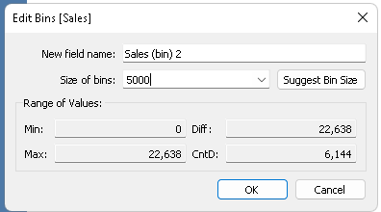

Slide 17
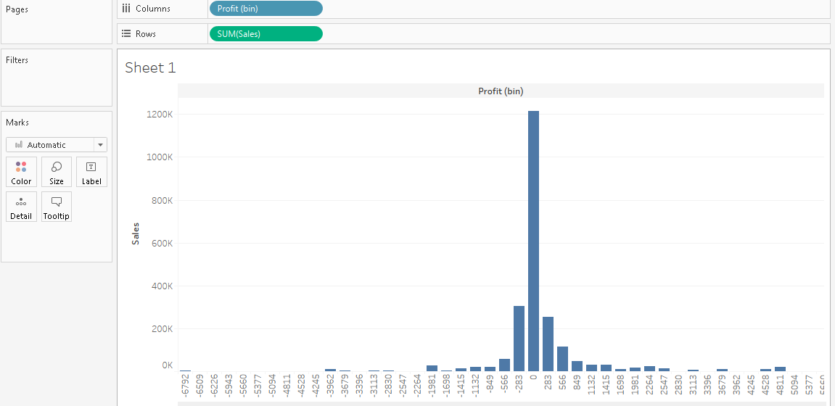

Slide 18
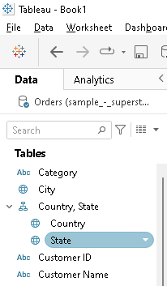
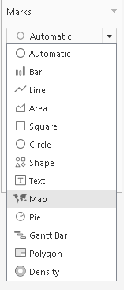
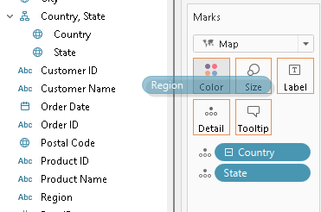
2.6 Maps
Create hierarchy
> double click states
> Under Marks card
>select Map
> Drag region to colour

Slide 19
Maps contd…
Maps are a no-brainer for visualizing any kind of location information, whether it’s postal codes, state abbreviations, country names, or your own custom geocoding.
If you have geographic information associated with your data, maps are a simple and compelling way to show how location correlates with trends in your data

Slide 20
2.7 Dual Axis Charts
There are several different ways to compare multiple measures in a single view. You can:
Create individual axes for each measure.
Blend two measures to share an axis.
Add dual axes where there are two independent axes layered in the same pane.

Slide 21
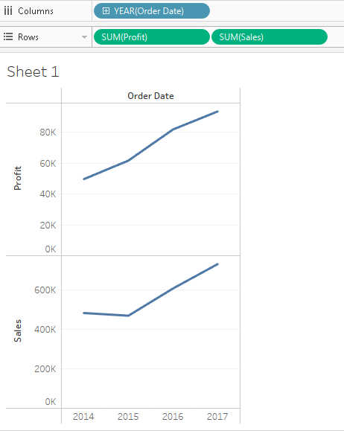

Slide 22
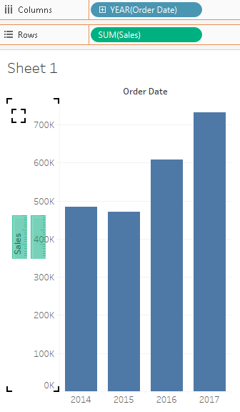
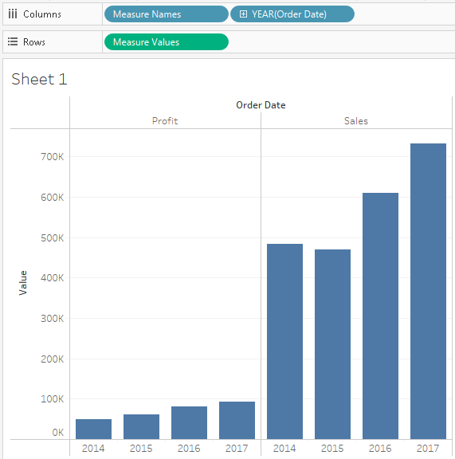
2.7.1 Create individual axes for each measure

Slide 23
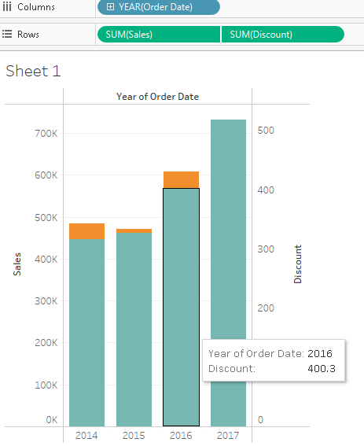
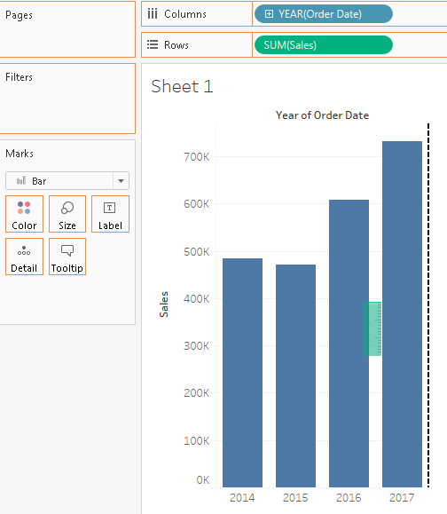
2.7.2 Blend two measures to share an axis.

Slide 24
Compare two measures using dual axes

Slide 25
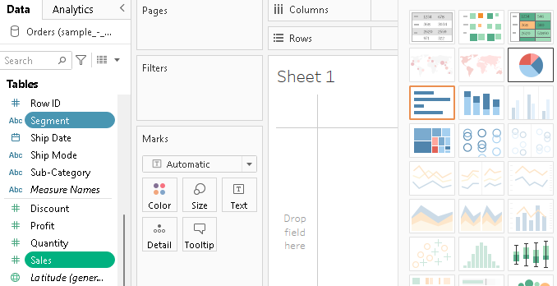
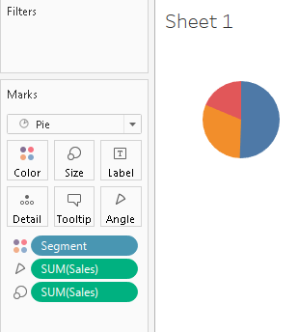
2.8 Pie Charts

Slide 26
3. Visualization data with advanced analytics
Polygon Maps
Bump Charts
Control charts
Funnel charts
Pareto charts
Waterfall charts

Slide 27
3.1 Polygon Maps
allows you to map custom shapes.
created by looking up the coordinates of the shape you want to draw, and then connecting the dots by drawing a path between them.
The main difference between a polygon map and a path map is that you “close the loop” around the dots.
A polygon map represents geographic areas using colored polygons such as counties, states.

Slide 28
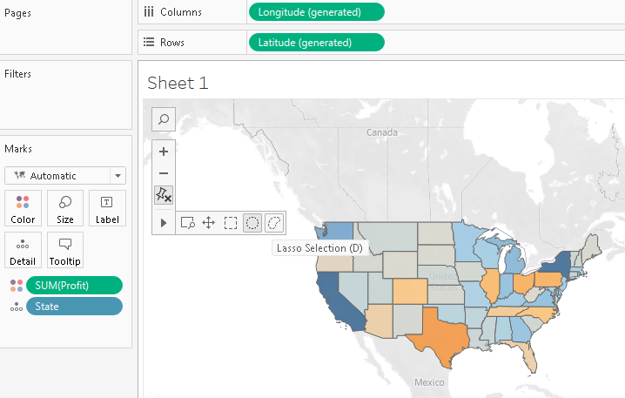

Slide 29
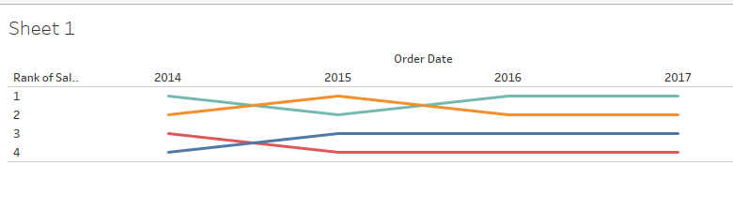
3.2 Bump Charts
A bump chart is used to show the progression of value or dimension with respect to another dimension over time.
It follows a rank system where the changes in the rank of particular field values are noted over a period.
Used to compare two dimension values.
We normally use two dimension fields and at least one measure field to create a bump chart in Tableau

Slide 30
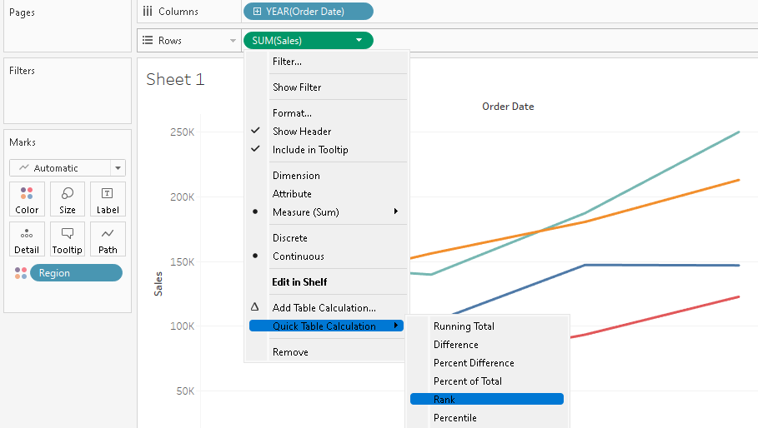
https://data-flair.training/blogs/tableau-bump-chart/

Slide 31
What is ranking in data analysis?
Ranking in statistics and data analysis refers to ordering data points from least to greatest (or vice versa) and giving each data point an ordinal number (i.e. 1, 2, 3, ...).

Slide 32
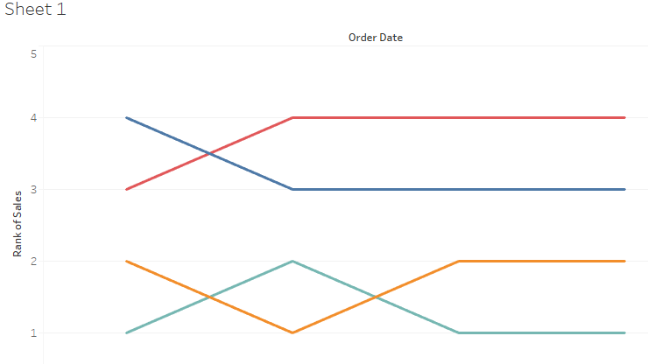
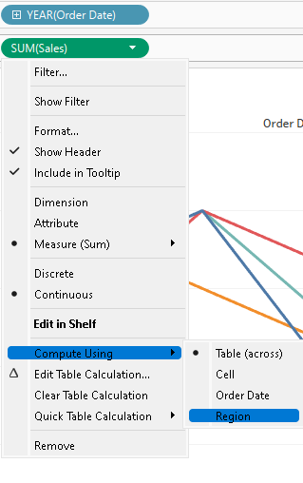
This will arrange the lines of the line chart according to the ranks of their data points. Also, right now that measure values are continuous type which we need to make Discrete

Slide 33
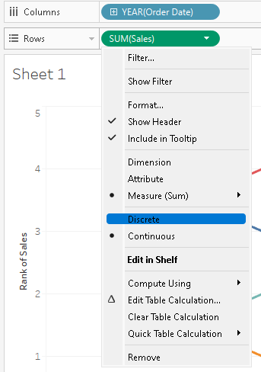
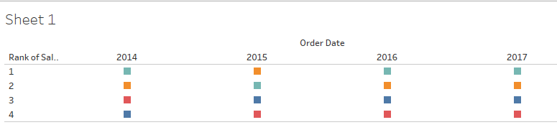
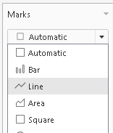

Slide 34
3.3 Control charts
Standard deviation is used to show how far away data is from the mean.
This is used because when data is far from the mean, it can be a random ‘event’ or erroneous data.
Therefore, the measure of standard deviation is often used to identify outliers/ spikes in the data for further analysis.
A control chart uses standard deviations above and below the mean. These are displayed as a band around the mean in the control chart, with outliers identified using colour.

Slide 35
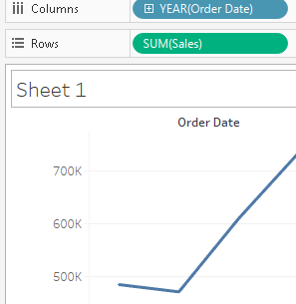
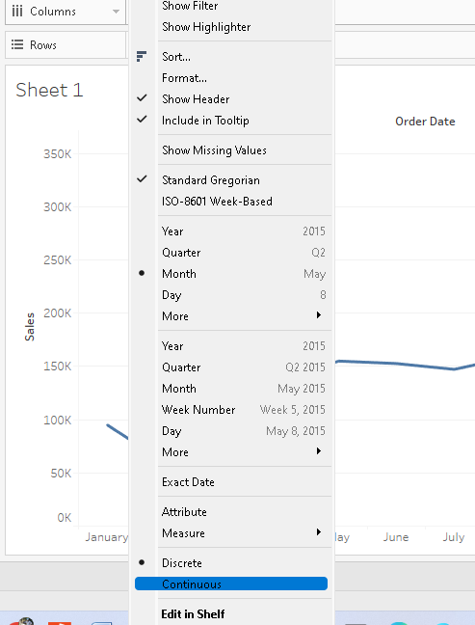
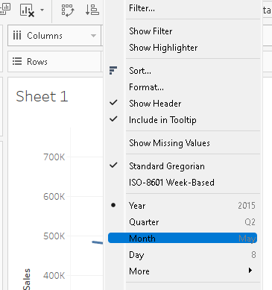

Slide 36
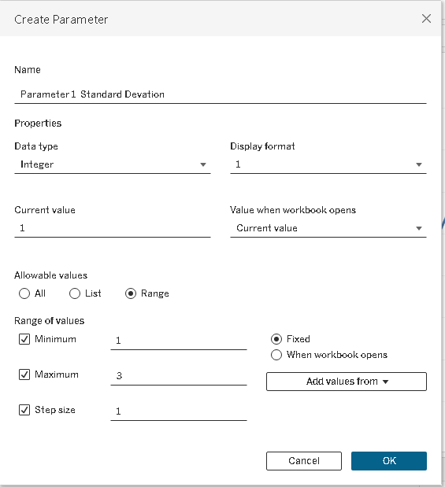

Slide 37
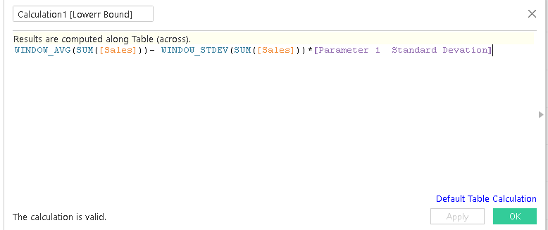
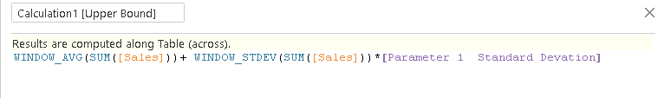
WINDOW_AVG - is a table calc that averages over the data in the window only, or a subset of that if required.
WINDOW_AVG(SUM([Sales]))+ WINDOW_STDEV(SUM([Sales]))*[Parameter 1 Standard Devation]
WINDOW_AVG(SUM([Sales]))- WINDOW_STDEV(SUM([Sales]))*[Parameter 1 Standard Devation]

Slide 38
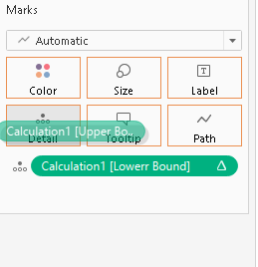
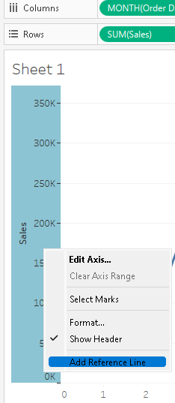
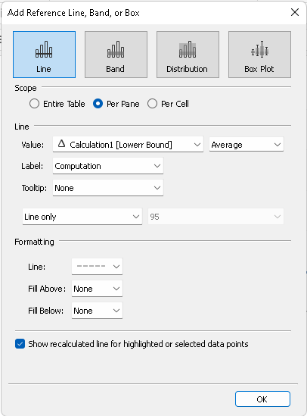

Slide 39
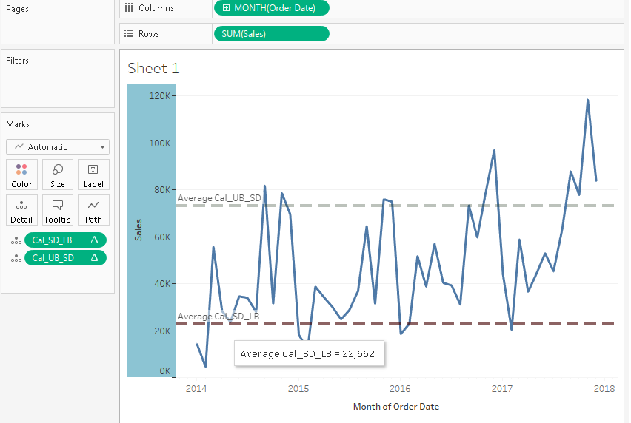

Slide 40
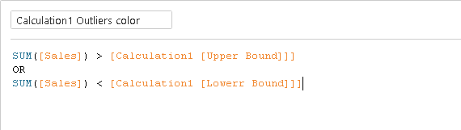
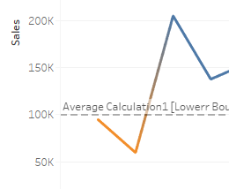
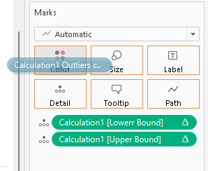


Slide 41
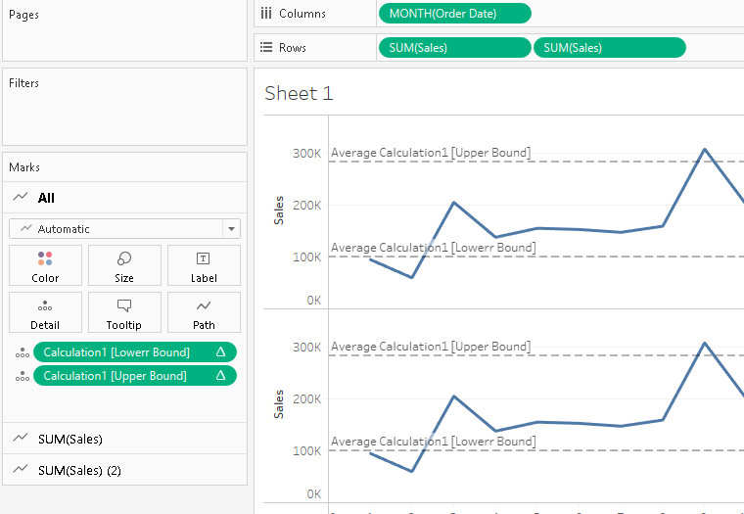

Slide 42
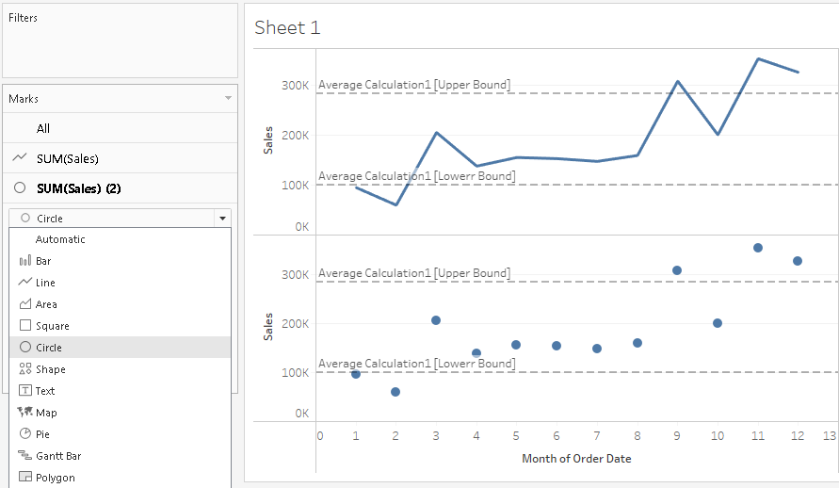

Slide 43
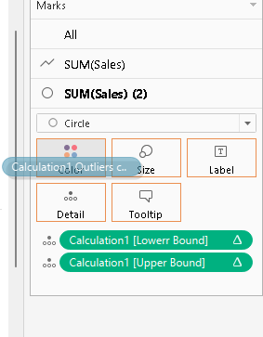
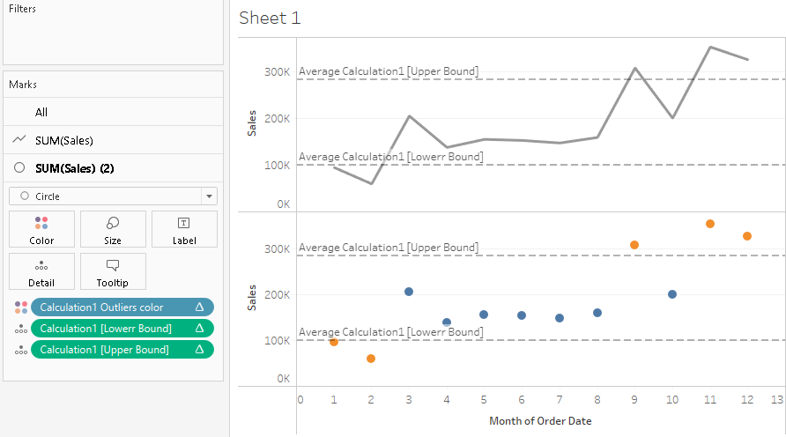

Slide 44
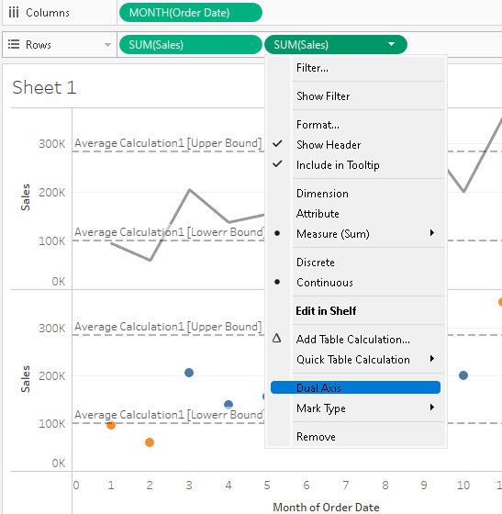

Slide 45
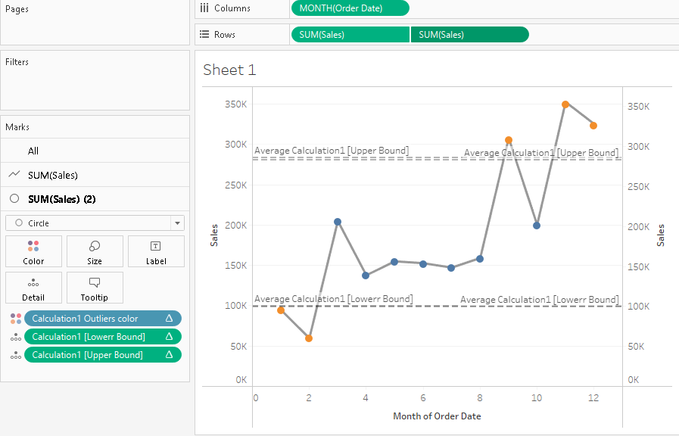
Notes:
https://www.thedataschool.co.uk/ellie-mason/how-to-create-a-control-chart-in-tableau-including-a-control-parameter/

Slide 46
3.4 Funnel charts
A funnel chart is a graphical representation that resembles the shape of a funnel where each segment gets progressively narrower. The segments are arranged vertically to showcase a hierarchy.

Slide 47
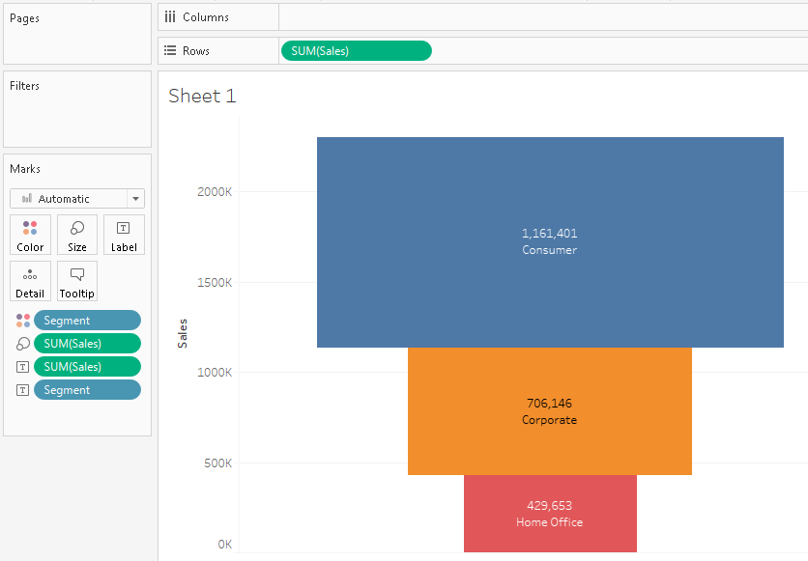

Slide 48
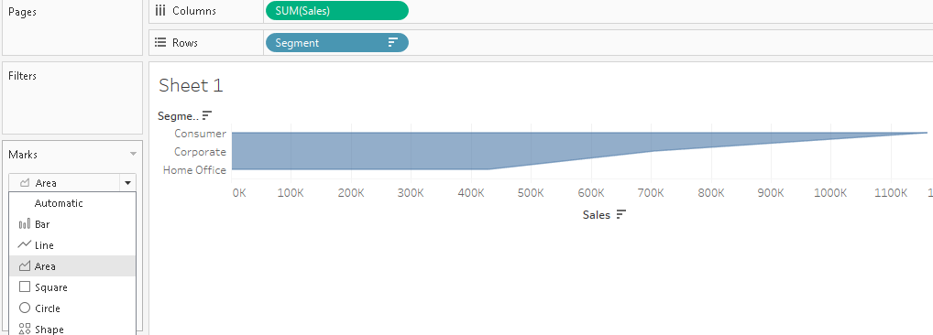
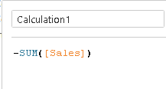

Slide 49
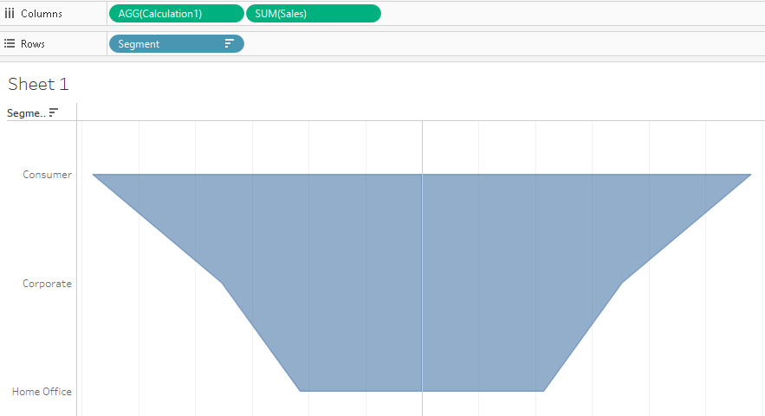

Slide 50
3.5 Pareto charts
A Pareto chart is a type of chart that contains both bars and a line graph, where individual values are represented in descending order by bars, and the ascending cumulative total is represented by the line.
It is named for Vilfredo Pareto, an Italian engineer, sociologist, economist, political scientist, and philosopher, who formulated what has become know as the Pareto principal.
Pareto made the observation that 80% of land was typically owned by 20% of the population.
roughly 80% of the effects come from 20% of the causes.
https://help.tableau.com/current/pro/desktop/en-us/pareto.htm

Slide 51
https://www.youtube.com/watch?v=-QKaGzROFc8

Slide 52
In Tableau, you can apply a table calculation to sales data to create a chart that shows the percentage of total sales that come from the top products, and thus identify the key segments of your customer base that are most important for your business's success.
The procedure uses the Sample - Superstore data source.
Create a bar chart that shows Sales by Sub-Category, in descending order.
Add a line chart that also shows Sales by Sub-Category.
Add a table calculation to the line chart to show sales by Sub-Category as a Running Total, and as a Percent of Total

Slide 53

Drag Sales to the far right of the view, until a dotted line appears.

Slide 54


Slide 55


Add a table calculation to the line chart to show sales by Sub-Category as a running total, and as a percent of total

Slide 56


Slide 57


3.6 Waterfall charts
A waterfall chart is a form of data visualization that helps in understanding the cumulative effect of sequentially introduced positive or negative values.

Slide 58


Slide 59


4. Usage and filtration of data with charts

Slide 60
4.1 Visualizing categorical data
Bar Charts and Pie Charts are used to visualize categorical data.
Both types of graphs contain variations as displayed in the visual.

Slide 61
4.2 Visualizing time series data
Bubble Plot: Bubble plots represent time series data using bubbles, where each bubble represents a data point with its size or color encoding a specific measurement value.
Scatter Plot: Scatter plots display the relationship between two variables by plotting data points as individual dots on a Cartesian plane.
Linear Line Plot: Linear line plots connect consecutive data points with straight lines, emphasizing the trend and continuity of the data over time.

Slide 62
4.3 Visualizing multiple variables
Geometric representation is an important type of visualisation in multivariate analysis.
Techniques like scatter plots, parallel coordinate plots, and multidimensional scaling are utilised for transforming complicated data into geometric forms and patterns.

Slide 63


4.4 Visualizing geospatial data
These visualizations focus on the relationship between data and its physical location to create insight. Any positional data works for spatial analysis.
Geovisualization overlays variables on a map using latitude and longitude to foster insight.

Slide 64

4.5 Mapbox integrations

Slide 65

https://www.youtube.com/watch?v=baH_PPbk_mk

Slide 66
5.1 Web Mapping Services
In Tableau Desktop, you can connect to map servers with the Web Map Service (WMS) protocol.
WMS is a standard protocol for requesting and receiving geographically referenced imagery.
Connect to a WMS server
In Tableau Desktop, select Map > Background Maps >WMS Servers.
In the Add WMS Servers dialog box, type the URL for the server you want to connect to in Tableau, and then click OK.
https://help.tableau.com/current/pro/desktop/en-us/maps_mapsources_wms.htm

Slide 67
5.2 Background Images
Background images are images that you display underneath your data in order to add more context to the marks in the view.
A common use of background images is adding custom map images that correspond to a coordinate system in your data.

Slide 68



Slide 69




Slide 70



Drag and drop X and Y measure

Slide 71



